Slide 1
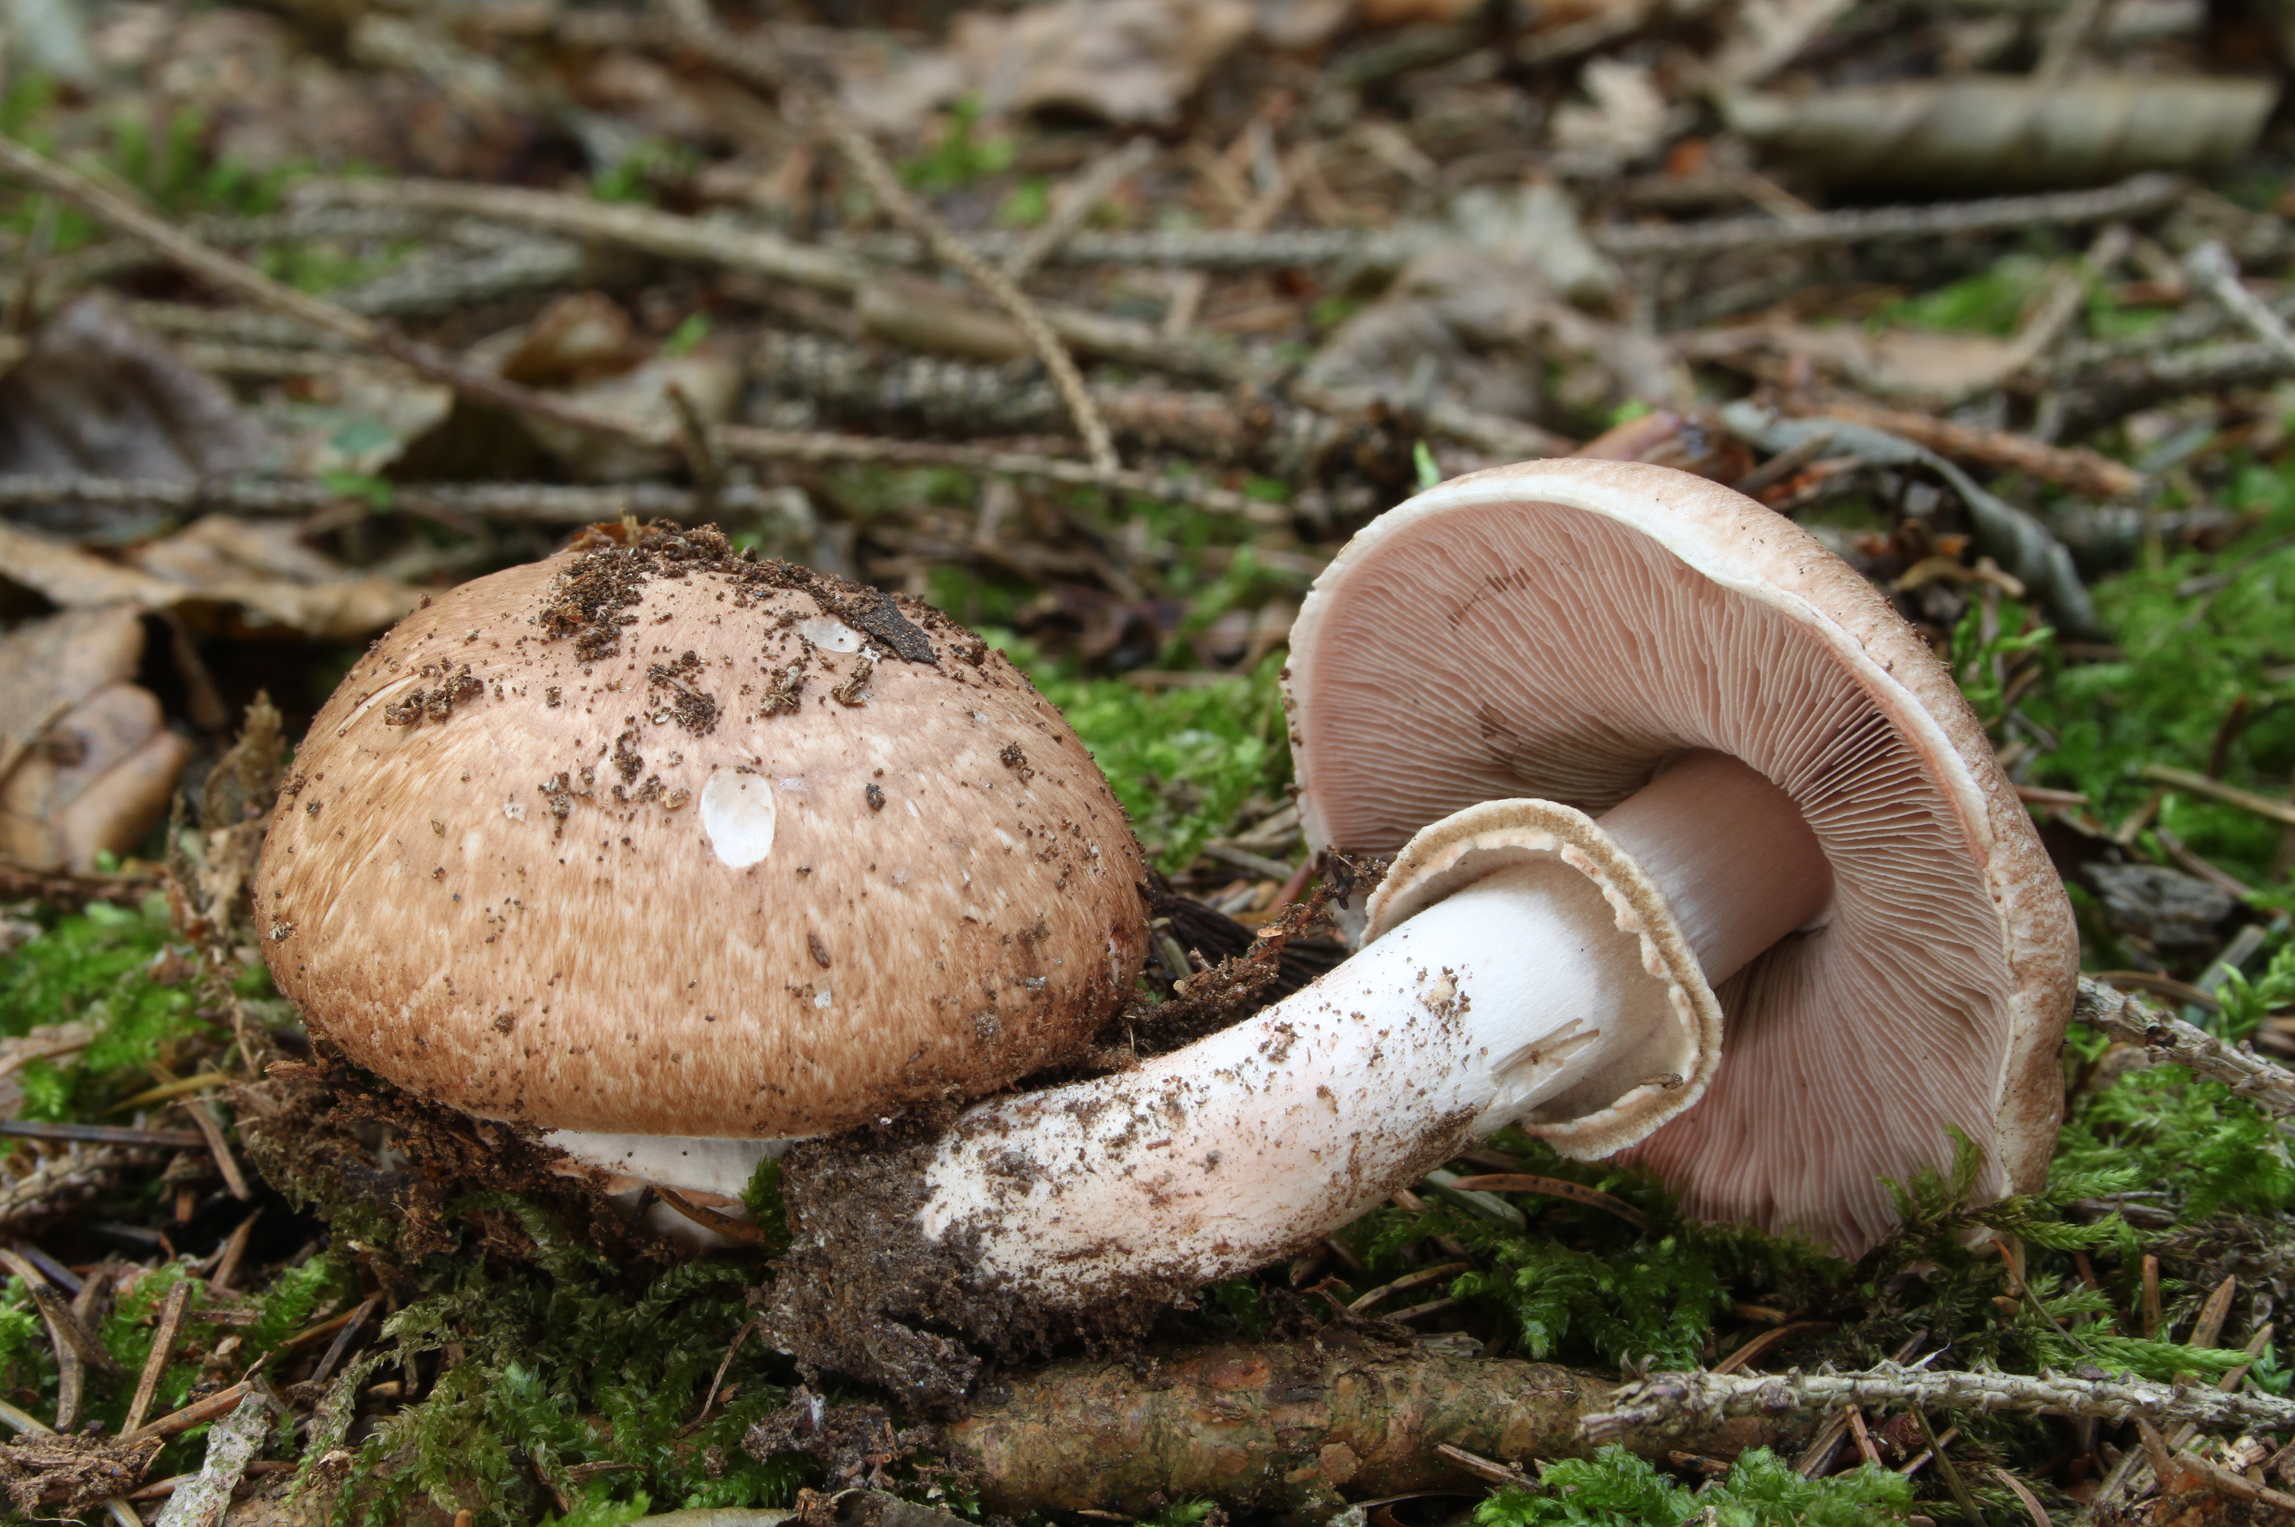
The Prediction of Mushroom Edibility Using Machine Learning
Ben Sturm
May 16, 2018

Slide 2

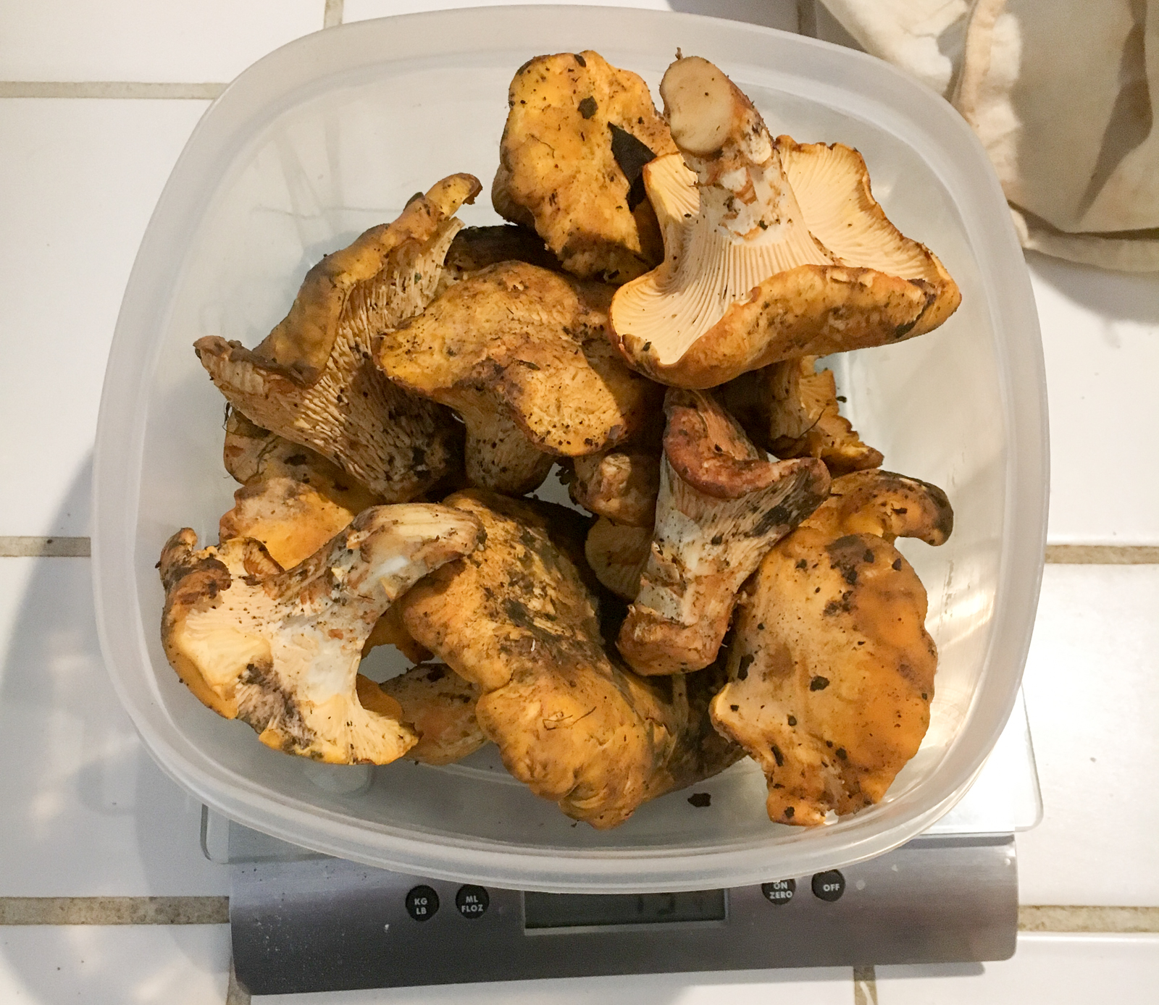
Hunting edible mushrooms in the wild can be an exciting and rewarding process
Hunter-Gatherers
The Trophy

Slide 3
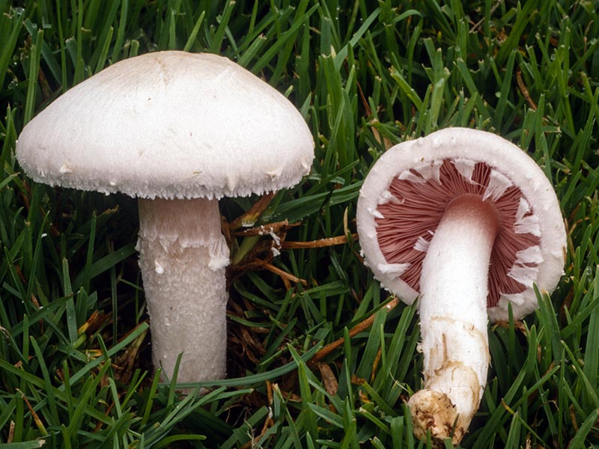
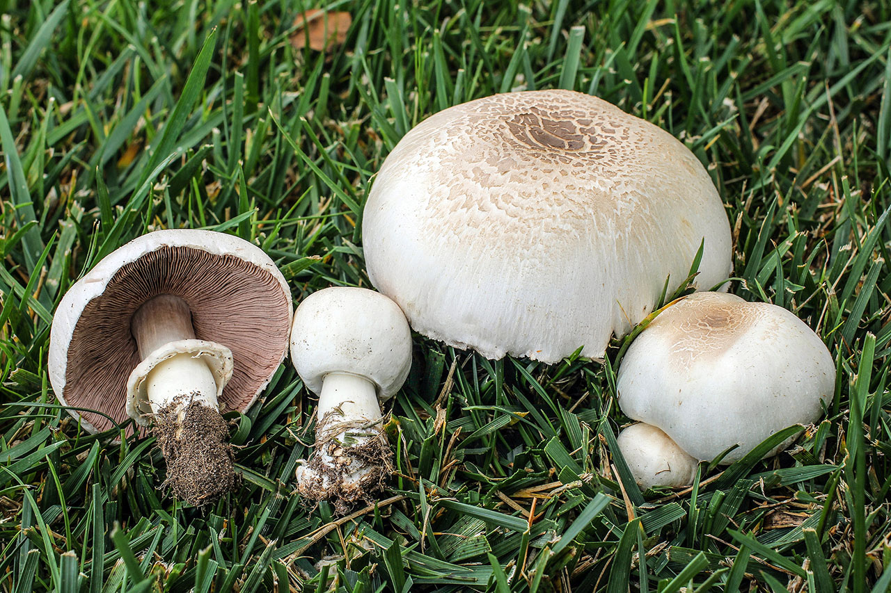
Wouldn’t it be great if you could determine whether a mushroom you encounter in nature is poisonous or not with machine learning?
Agaricus Campestris (Non-poisonous)
Agaricus Californicus (Poisonous)

Slide 4
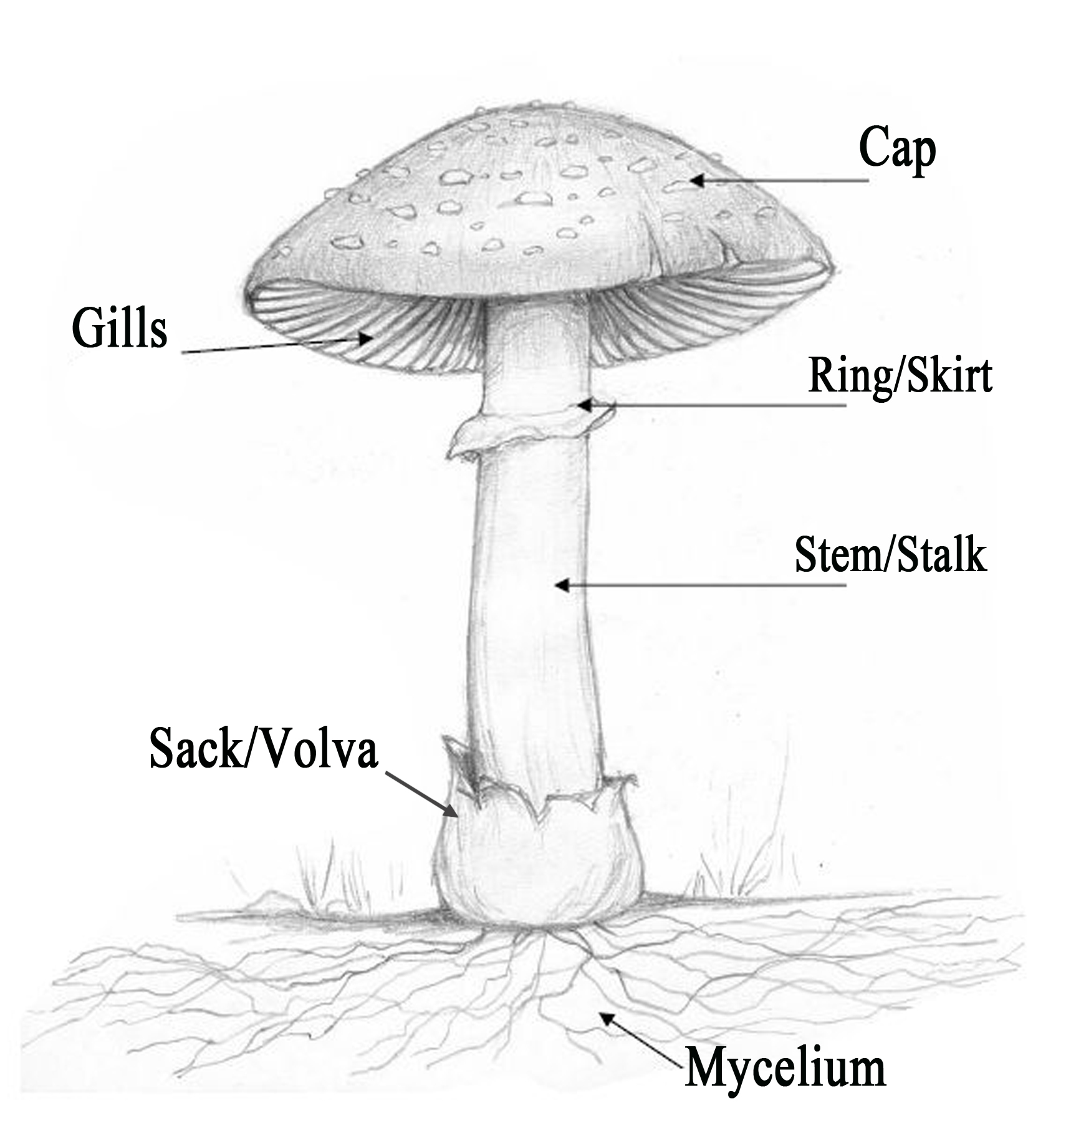
Wouldn’t it be great if you could determine whether a mushroom you encounter in nature is poisonous or not with machine learning?
 | Agaricus campestris (non-poisonous) | Agaricus californicus (poisonous)
cap color | white | whitish to brown
gill color | pink (young), chocolate brown (mature) | pink (young), chocolate brown (mature)
ring | no | yes
bruises? | no | yes
habitat | grass | forest and grass
odor | mild, mushroomy | antiseptic

Slide 5
For this project, I used the UCI Mushroom Data Set to determine if machine learning could be used to classify the edibility of mushrooms
The data set consists of mushrooms from 2 different families only (Agaricus, Lepiota)
Number of instances = 8124
Number of features = 22
All features are categorical
Target variable is edibility
52% edible
48% non-edible
Features:
• Cap-shape, Cap-surface, Cap-color
• Bruises?
• Odor
• Gill-attachment, Gill-spacing, Gill-size, Gill-color
• Stalk-shape, Stalk-root, Stalk-surface-above-ring, Stalk-surface-below-ring
• Stalk-color-above-ring, Stalk-color-below-ring
• Veil-type, Veil-color
• Ring-number, Ring-type
• Spore-print-color
• Population
• Habitat

Slide 6
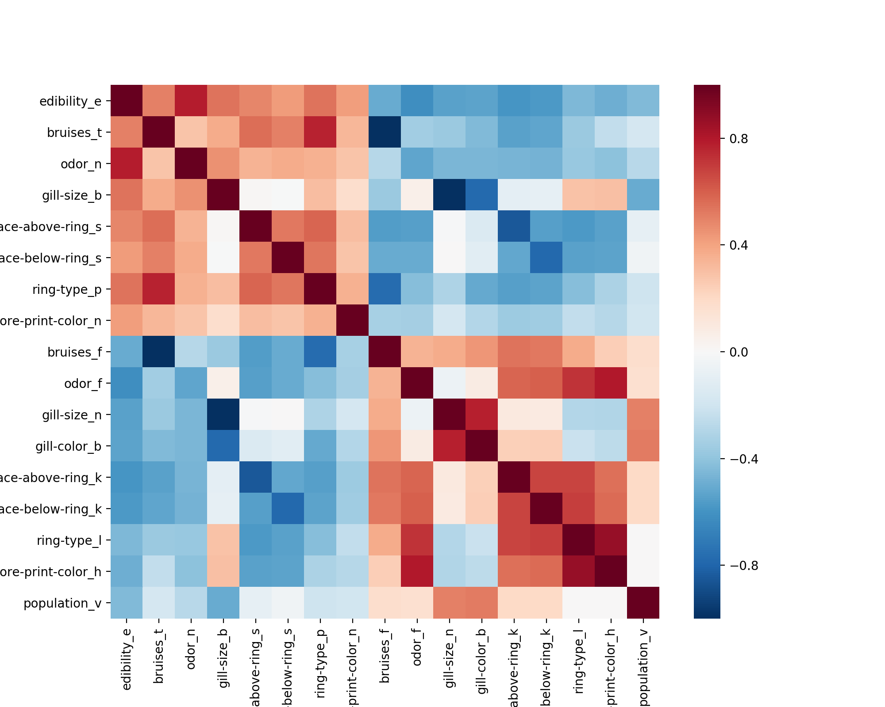
Certain features are strongly correlated with edibility
Corr = .786
Corr = -.624

Slide 8
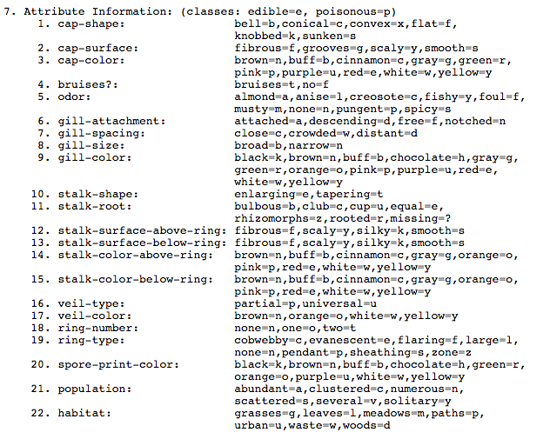
Appendix: Mushroom Attribute Information

